Slide 1
AWS Nitro System
Lecturer: Ngo Huy Bien
Software Engineering Department
Faculty of Information Technology
University of Science
Ho Chi Minh City, Vietnam
nhbien@fit.hcmus.edu.vn

Slide 2

Objectives

Slide 3

Contents

Slide 4

References
Mark Wilkins (2019). Learning Amazon Web Services (AWS). Addison-Wesley Professional.

Slide 5
AWS Initial Hypervisors [1]
For many years, the standard answer for “what hypervisor does AWS deploy?” was a customized version of the Xen hypervisor.
Initial versions offered Xen paravirtualization for the Linux operating system and, over time, the hardware virtual machine (HVM) for support of the Windows operating system.
EC2 instances running Windows were initially hosted differently from Linux using the previously mentioned HVM.
Paravirtualization was possible with Linux because it was an open source operating system.
On the other hand, Windows remains a closed operating system; therefore, paravirtualization is not possible with Windows EC2 instances.

Slide 6
PVHVM
In 2012, the customized version of Xen used by AWS ran in a hybrid model that installed on Intel processors equipped with hardware virtualization (VT-x).
These processors offered faster CPU and memory access.
They also used paravirtualized drivers to access the network and storage devices as quickly as possible.
These two separate virtualization features were beginning to be combined in a hybrid model called PVHVM (paravirtualization and hardware-assisted virtualization technology combined).

Slide 7
2013 Xen Hypervisor
At the start of 2013, the Xen hypervisor supported a combination of PVHVM drivers and hardware virtualization for the network interfaces called single-route I/O virtualization (SR-IOV).
Several EC2 instances also began to offer support for enhanced networking, using SR-IOV, which offered initial speeds of 10 Gbps.
Today speeds can reach 25 Gbps, or 100 Gbps with GPU instances.

Slide 8
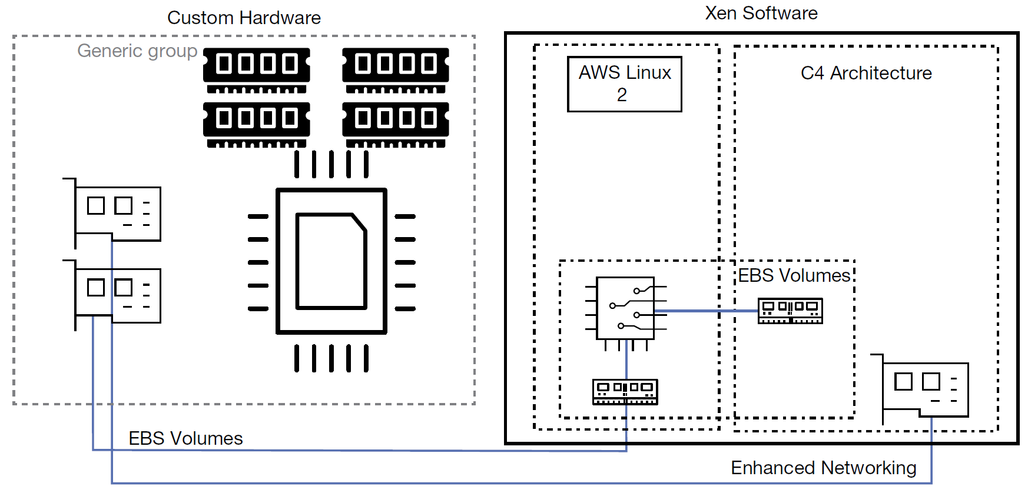
C4 Instance
AWS introduced the C4 instance in 2015. Amazon had been working with a startup company called Annapurna Labs, which created custom semiconductor circuits; it is now an AWS company.
The C4 instance that used the custom chipsets designed with Annapurna offered such a high level of storage and network performance that EBS-optimized volumes were offered by default at no additional charge.

Slide 9
X1 Instance
The X1 instance was released with 128 virtual CPUs (vCPUs) and 2 TB of memory in 2016.
Custom chipsets allowed access to the high-speed instance storage.
An enhanced networking interface that had been specifically designed for EC2 instances was also introduced.

Slide 10
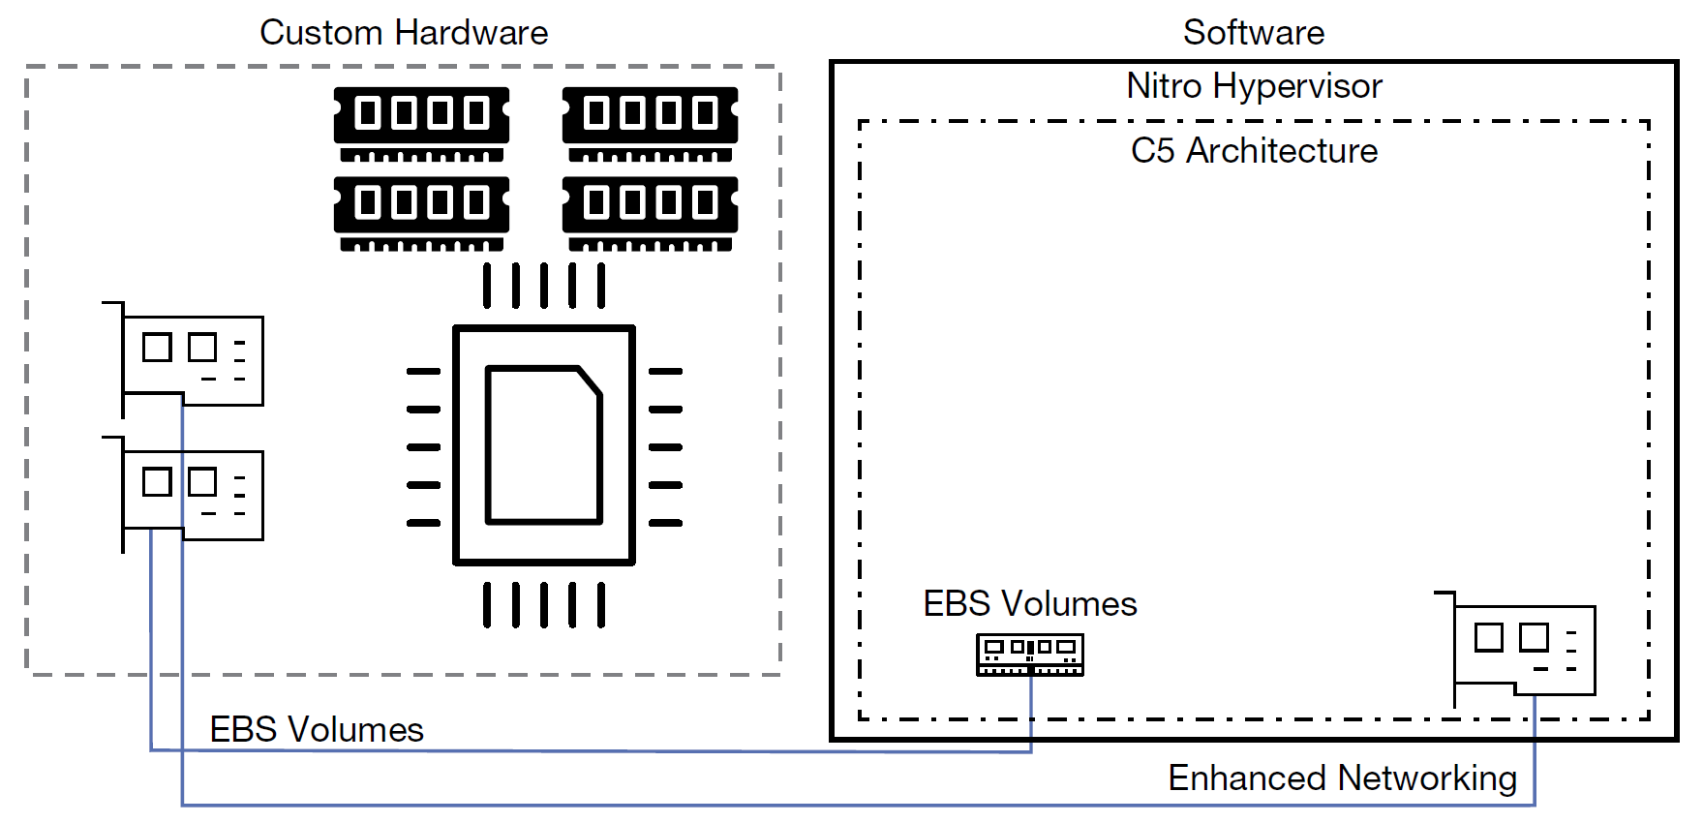
C5 Instance
The next task AWS carried out was replacing the Xen hypervisor with a new lightweight hypervisor called Nitro.
The C5 instance launched in 2017. It was deployed using the Nitro hypervisor and offloaded the networking, storage, and management tasks such as encryption duties to hardware, greatly reducing the duties of the hypervisor and increasing the speed at which operations were carried out.

Slide 11


Slide 12
The Nitro System
In 2017, the new Nitro hypervisor was launched.
As mentioned, the heart of the Nitro hypervisor uses just the KVM core kernel and a streamlined virtual machine manager (VMM).
Older KVM emulation components such as QEMU are not used.
The term direct metal access has been coined by AWS providing the performance equivalent of a bare-metal server.
To achieve this goal, AWS designed custom silicon chipsets that use hardware processes for faster access to storage, networking, interrupts, and carrying out security processes such as encryption.
Over time, Nitro will be the only hypervisor used at AWS, except for the AWS i3.metal instances, which don’t use a hypervisor but are still called instances.

Slide 13
Nitro System Components
Local NVMe Storage—Custom chipsets provide direct access to high-speed local storage over a Peripheral Component Interconnect (PCI) interface connection, a standard used to connect EC2 instances to the local block storage.
Nitro Security Chip—The main component handling security in this design is the Nitro security chip, which, if you’re familiar with Intel TXT, is carrying out many of the same security functions: protecting the system’s boot process, and monitoring and approving or denying instance request calls for access to the storage resources.
Nitro Networking—Hardware-level networking supports the mapping service for the virtual private cloud (VPC), enhanced networking, and the elastic networking adapter (ENA).

Slide 14
EC2 Instances (I)
At AWS, virtual servers are called Elastic Compute Cloud (EC2) instances.
At the most basic level, each instance is a virtual server running a version of Windows or Linux.
Instances run as a guest operating system hosted by the hypervisor, which in turn is directly installed on a bare-metal server.
General-Purpose Instances (m4, m5): the underlying concept for a general-purpose instance is to provide a baseline of CPU processing, network, and storage.
Some general-purpose models, such as T2 and T3 instances, are designed with the ability to burst above an initial assigned CPU baseline of performance.

Slide 15
EC2 Instances (II)
Compute-optimized instances (C4, C5) are designed for batch processing workloads, media transcoding, and high-performance applications or Web servers.
Workloads that need to process vast data sets hosted in memory, such as MySQL and NoSQL databases, or Memcached and Redis in-memory cache stores, should use a memory-optimized instance (r4, r5, x1).
Storage-optimized instances (h1, d2, i3) are designed for workloads that require local SSD storage for large data sets.

Slide 17
AWS Nitro System
https://aws.amazon.com/ec2/nitro/
Traditionally, hypervisors protect the physical hardware and bios, virtualize the CPU, storage, networking, and provide a rich set of management capabilities.
With the Nitro System, we are able to break apart those functions, offload them to dedicated hardware and software, and reduce costs by delivering practically all of the resources of a server to your instances.

Slide 18
Nitro System Instance Types
https://docs.aws.amazon.com/AWSEC2/latest/UserGuide/instance-types.html?icmpid=docs_ec2_console#ec2-nitro-instances
The following instances are built on the Nitro System:
Virtualized: A1, C5, C5a, …, T3, T3a, T4g, high memory (u-*), VT1, X2gd, and z1d
Bare metal: a1.metal, c5.metal, c5d.metal, …, x2gd.metal, and z1d.metal
Both T3 and T3a instances offer the same configuration, CPU credits and network performance. The only difference is that T3 uses Intel processor while T3a uses AMD processor.

Slide 19
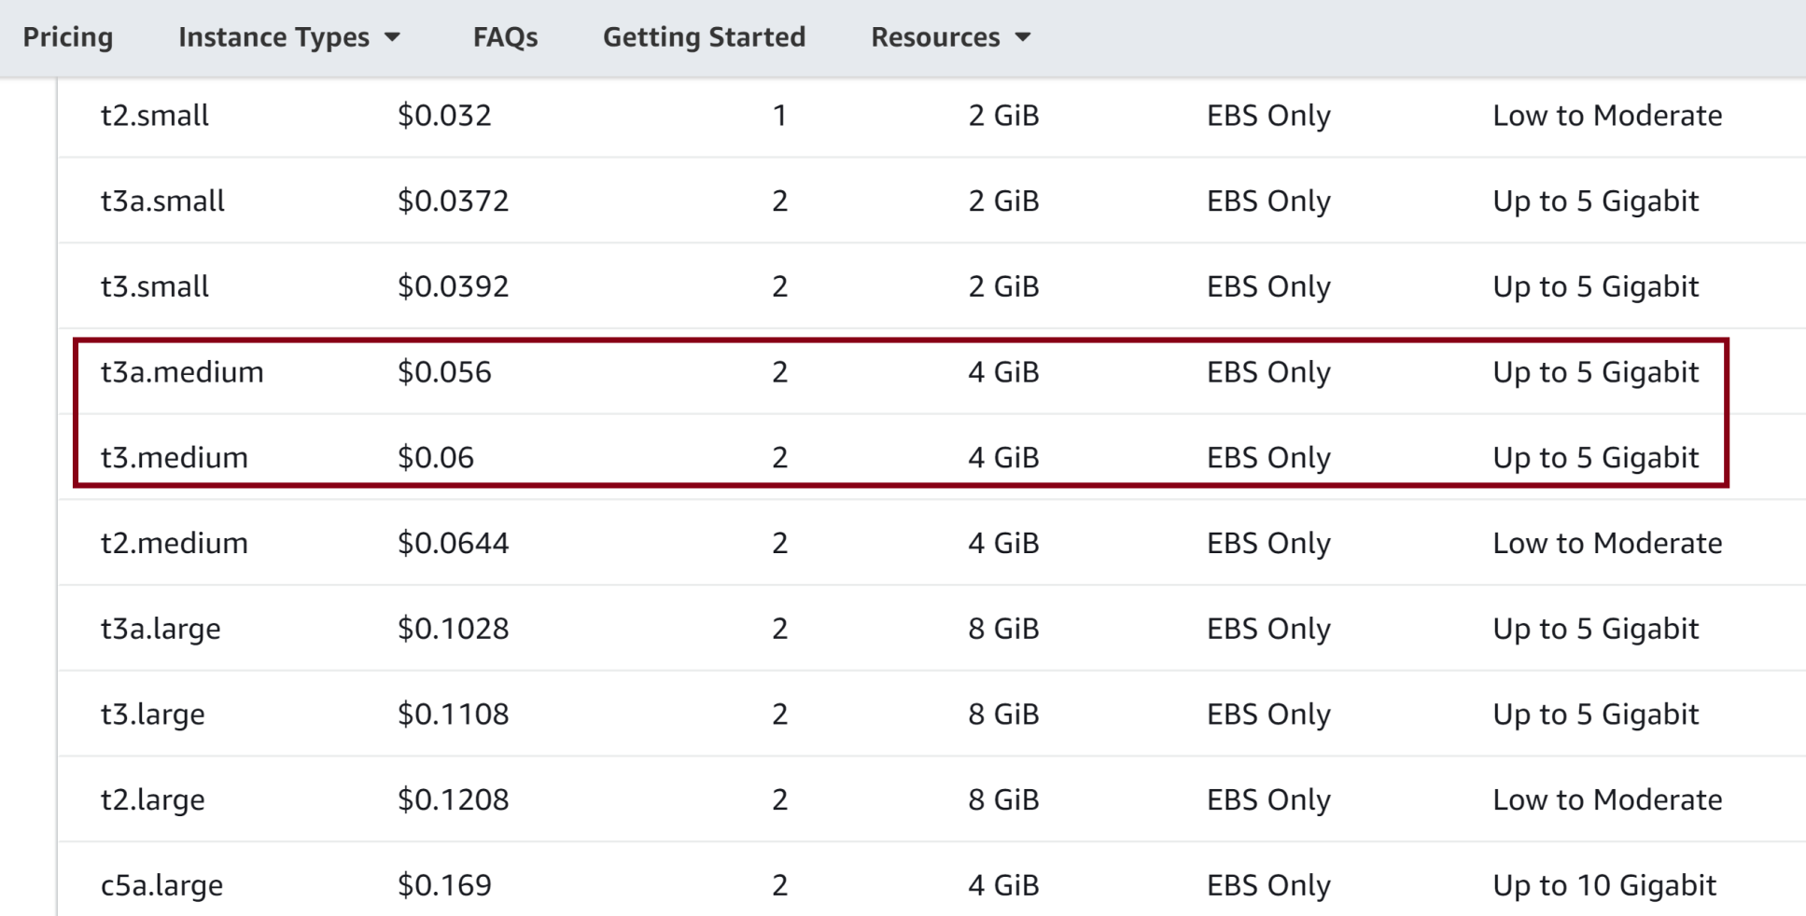
Instance Types Pricing
https://aws.amazon.com/ec2/pricing/on-demand/

Slide 20
Estimate Migration Cost
Identify necessary OS, CPU and RAM, e.g. Linux, 4CPU, 63Gb RAM.
Select appropriate COMPUTE (Instance name) for the need using https://aws.amazon.com/ec2/pricing/on-demand/, e.g. x2gd.large. We can filter by vCPU (e.g. 4), search for a number, e.g. 64, then sort by vCPU or RAM to locate appropriate instance name.
Extract price from the list, e.g. $0.334.
Calculate COMPUTE price for a year per instance. E.g. $0.334 x 24 x 365 = $2,925.84
Identify required disk space, e.g. 524Gb.
Select appropriate STORAGE for 524Gb using https://aws.amazon.com/ebs/pricing/, e.g. gp2, $0.1/Gb/month.
Calculate STORAGE price for a year per instance, e.g. $0.1 x 524 x 12 = $628,8.
Calculate COMPUTE and STORAGE price for a year per instance, e.g. $2,925.84 + $628,8 = $3535,8
Review the next 2 Slides for screenshots.

Slide 21
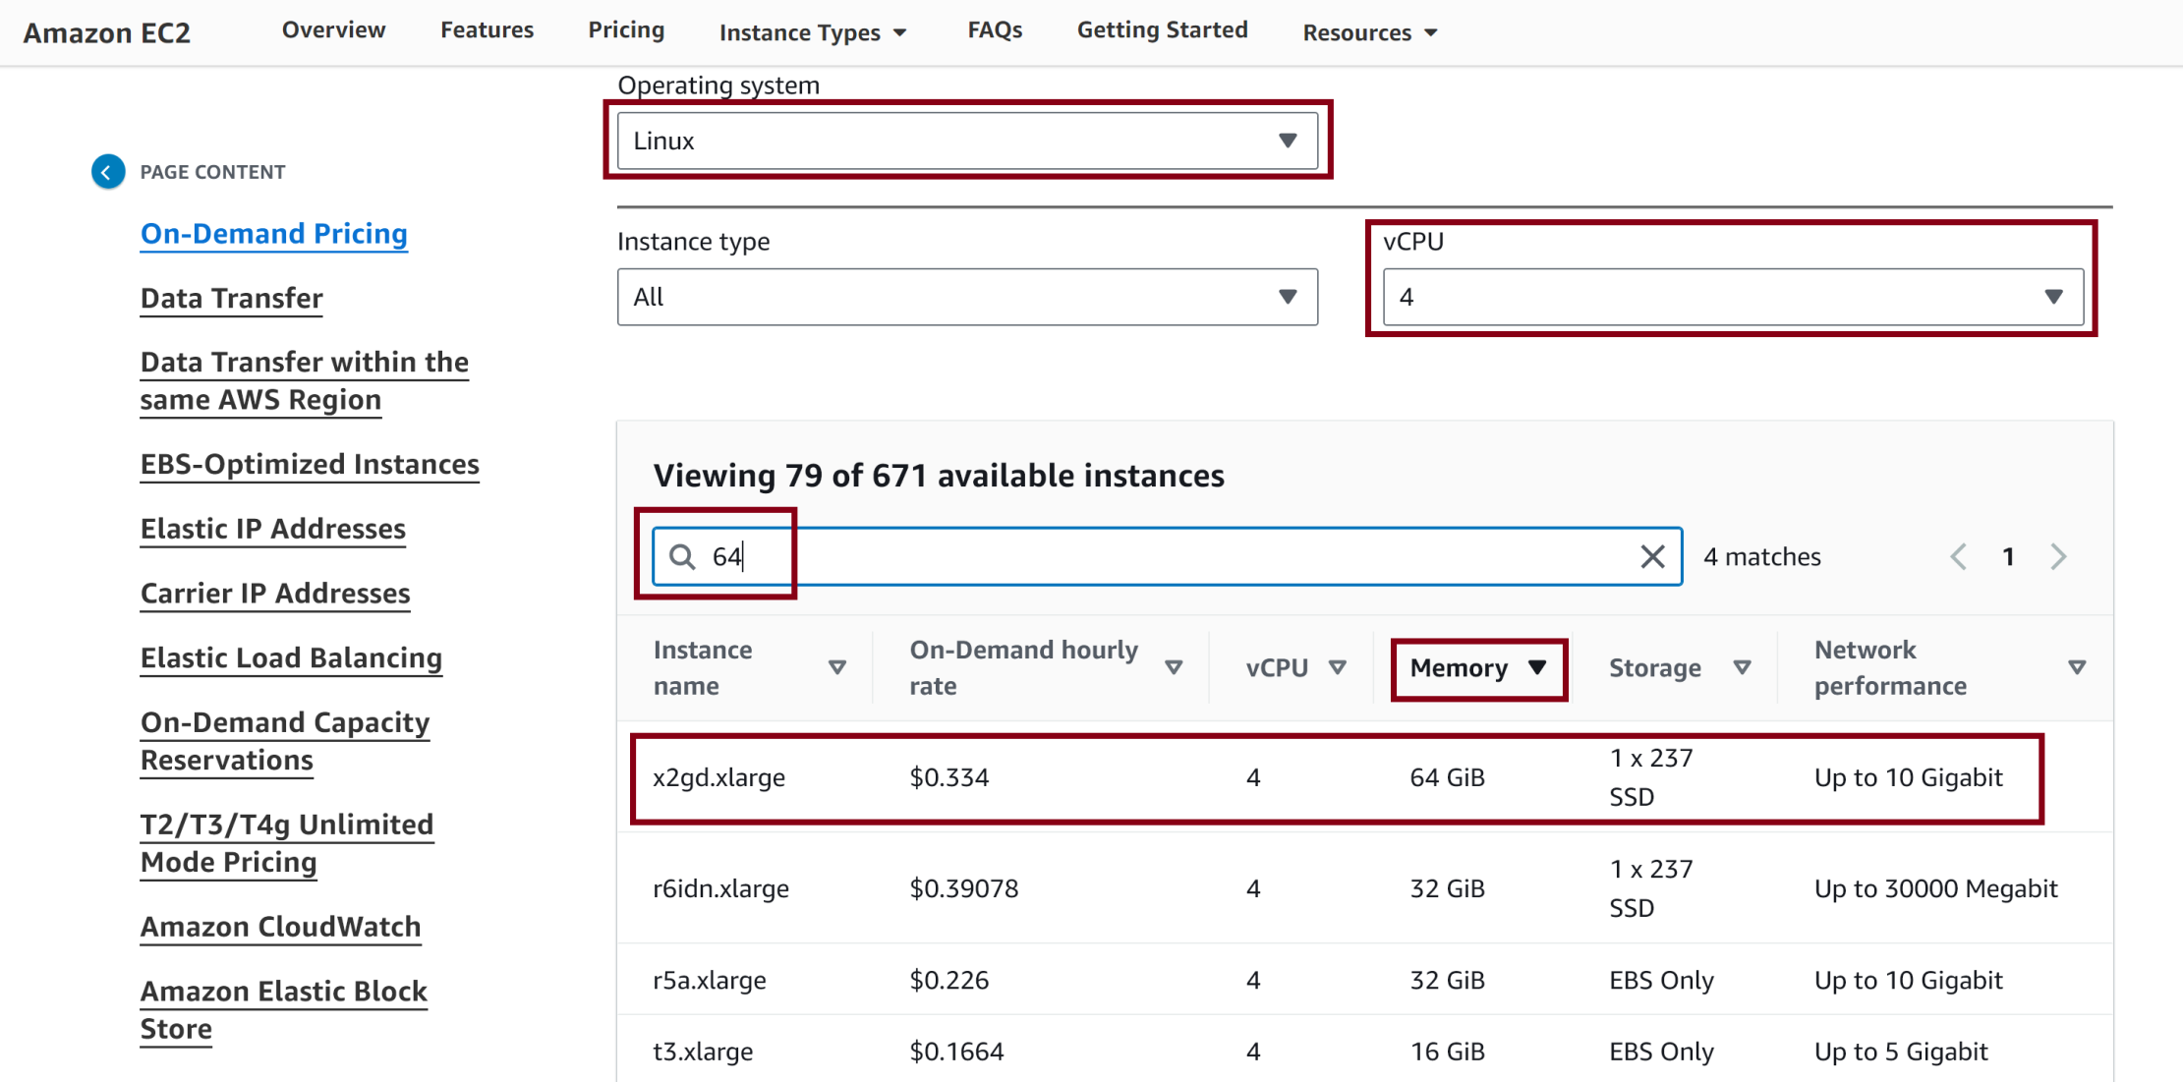
Select appropriate COMPUTE

Slide 22
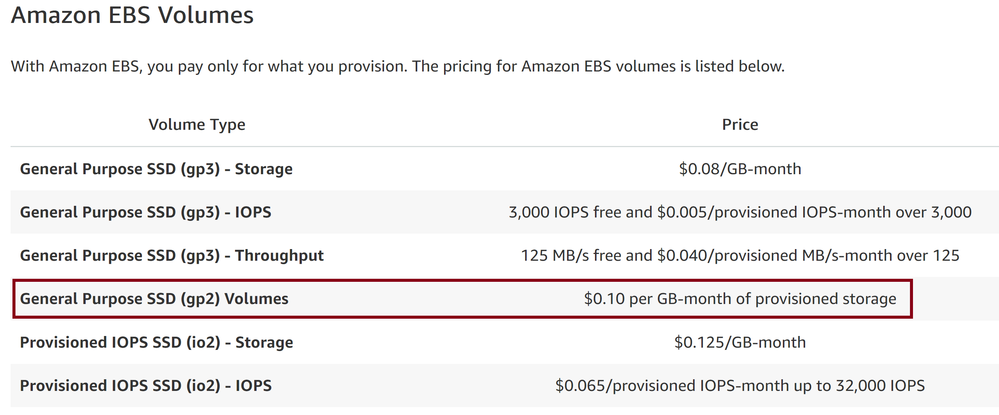
Select appropriate STORAGE

Slide 23
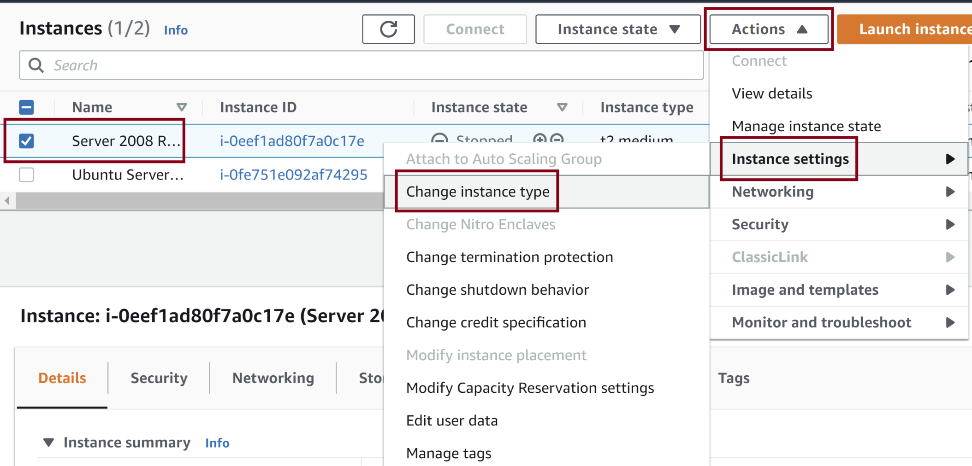
Change Instance Type
https://docs.aws.amazon.com/AWSEC2/latest/UserGuide/ec2-instance-resize.html?icmpid=docs_ec2_console

Slide 25
Elastic Network Adapter (ENA)
https://aws.amazon.com/about-aws/whats-new/2016/06/introducing-elastic-network-adapter-ena-the-next-generation-network-interface-for-ec2-instances/
ENA is a custom network interface optimized to deliver high throughput and packet per second (PPS) performance, and consistently low latencies on EC2 instances.
Using ENA, customers can utilize up to 20 Gbps of network bandwidth on certain EC2 instance types.

Slide 26
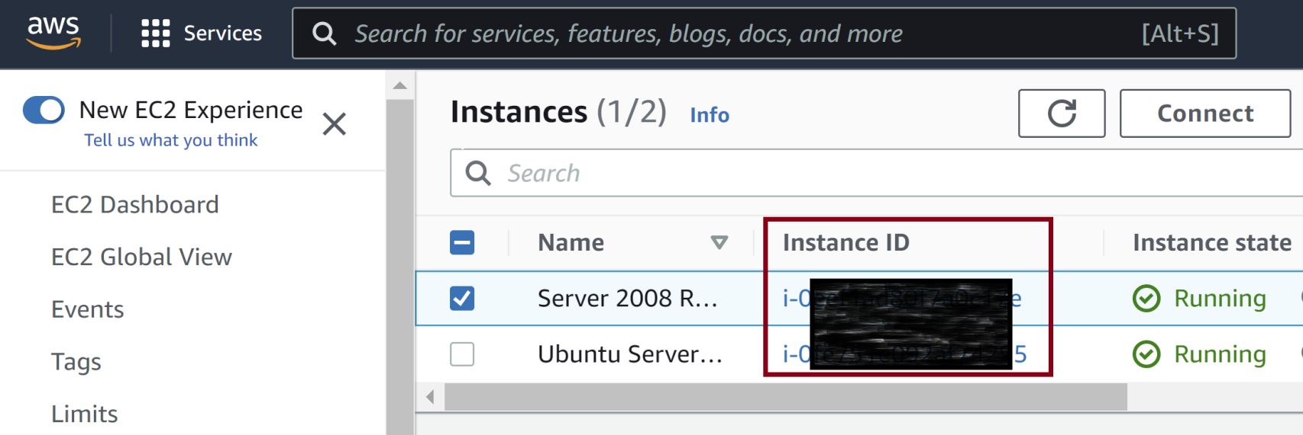
1. Retrieve Instance ID

Slide 27
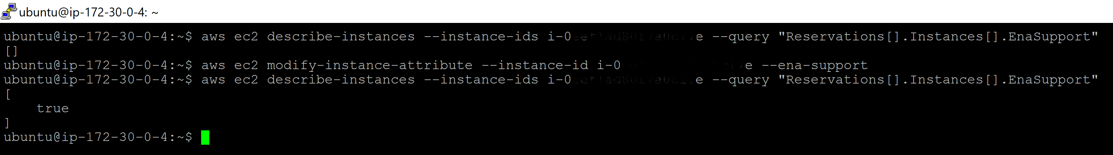
2. Enable ENA
aws ec2 describe-instances --instance-ids i-0e**************e --query "Reservations[].Instances[].EnaSupport"
aws ec2 modify-instance-attribute --instance-id i-0e**************e --ena-support
aws ec2 describe-instances --instance-ids i-0e**************e --query "Reservations[].Instances[].EnaSupport"

Slide 28
3. Install ENA Driver
https://docs.aws.amazon.com/AWSEC2/latest/WindowsGuide/enhanced-networking-ena.html
For Server 2008 R2: https://s3.amazonaws.com/ec2-windows-drivers-downloads/ENA/x64/2.2.3/AwsEnaNetworkDriver.zip

Slide 29

Thank You & See You Again

